Slide 1

Fundamentals of Cryptography Week 13

Slide 2
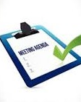
Week 13 Agenda
Week 13 Overview
Reading
Discussion Question
Quiz
Applied Cryptography

Slide 3
Discussion Question 10 PCI Security Standards
Peer Response(s): Peer Response(s) are due by Sunday, November 26th (11:59:59pm ET)
Primary Task Response:
Primary Task Response:
Primary Response: Primary Discussion Response is due by Wednesday, November 22nd (11:59:59pm Eastern Time Zone (ET))
Symposium Reflection
Following the Payment Council Industry Data Security Standards (PCI DSS) is just good business. Such standards help ensure healthy and trustworthy payment card transactions for the hundreds of millions of people worldwide that use their cards every day.
Please define and describe the PCI DSS
What data are thieves after?
What are potential liabilities from not following PCI DSS?
With regards to payment security:
What needs to be secured?
Where do thieves steal data?

Slide 4
Discussion Question 10
- Read the responses from your peers and offer a constructive critique or additional information that adds substantively to the discussions.
Peer Response
- Remember, a response that simply states that their post was good or that you liked it is not considered substantive and will not earn credit.
- You should contribute to the learning via your posts and responses.
- Be sure to acknowledge any outside sources you use.

Slide 5
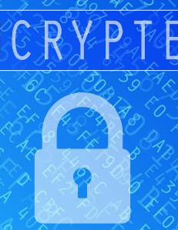

Week 13 Overview
Reading – Chapter 9: Applied Cryptography
Discussion Question 10 – PCI Security Standards
NO quiz this week

Slide 6
Applied Cryptography
How is cryptography applied?
Secure Socket Layer (SSL)
Encryption and Automated Teller Machines (ATM)
Working with digital signatures
Drive encryption

Slide 7
How is cryptography applied?
Secure communications
Identification and Authentication
E-commerce
Certification
Key recovery and management
Remote access
Digital Rights Management (DRM)

Slide 8

Secure Socket Layer (SSL)
SSL was developed by the Netscape corporation in the 1990’s
Transport Layer Security (TLS) and its predecessor, Secure Sockets Layer (SSL), both of which are frequently referred to as 'SSL', are cryptographic protocols designed to provide communications security over a computer network.
Uses
Secure Web traffic (HTTPS)
Microsoft and Google use it to secure the exchange of passwords for their email servers.
VPNs use it to encrypt all communications between clients

Slide 9
Secure Socket Layer (SSL)

Slide 10
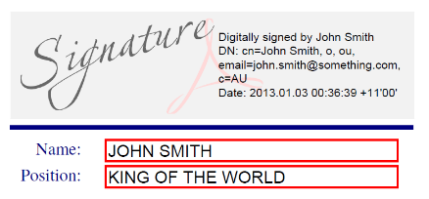
Working with digital signatures
Used to verify documents, transactions, and files.
Digital signatures provide
Guarantees that the document was actually sent by the sender
Guarantees that the file was not modified en route
Guarantees the authenticity of a document
Digital signatures are legally binding
As we saw previously in the term, digital signatures use both encryption and hashing technologies.

Slide 11
Encryption and ATMs
ATMs use multifactor authentication.
Encryption protects the pin and the account information
Newer machines are adding smartcards

Slide 12
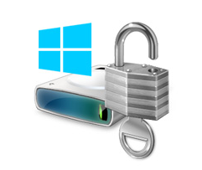
Drive encryption
You can protect data in motion and data at rest
Software to encrypt drives
Windows Vista (and later)
Bitlocker - By default it uses the AES encryption algorithm in cipher block chaining (CBC) with a 256-bit key
Built into Windows
Encrypts the entire drive
Windows XP
Truecrypt – Used DES
Can encrypt individual files and entire drives
Upgrade versions of Windows and migrate to Bitlocker
Mac OS X
Filevault 2 supports AES encryption with a 256-bit key
Built into the OS since OS X 10.3
Encrypts the entire drive

Slide 13

Week 14 – Quantum Cryptography
Reading – Chapter 10: Quantum Cryptography
Quiz 8

Slide 14

Questions?

